Slide 1
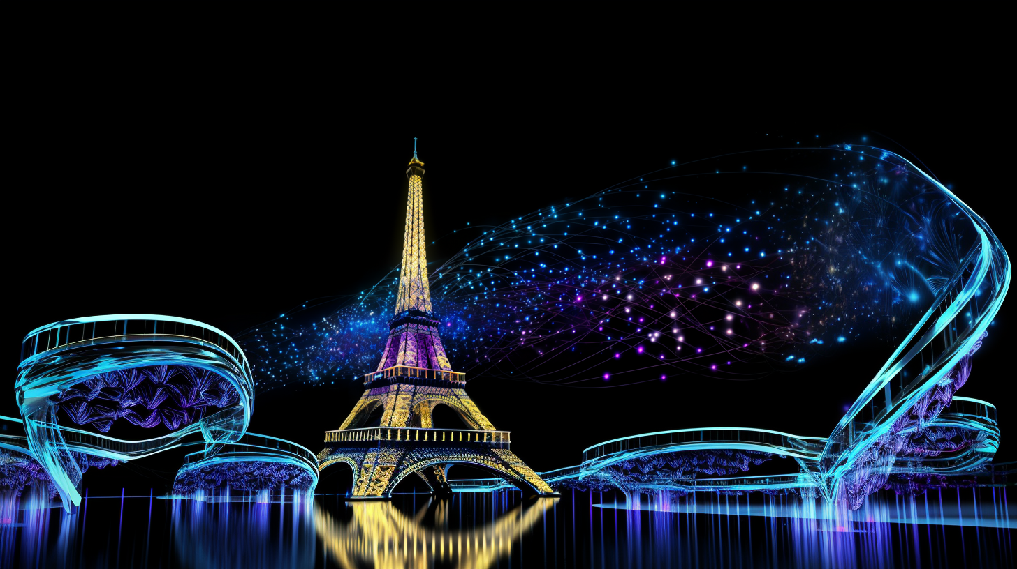
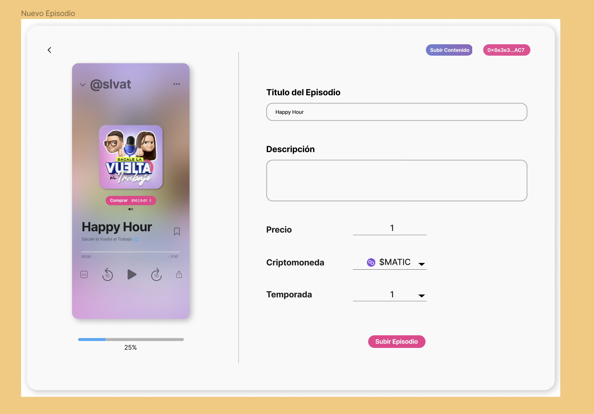

DigiMedia
A solution that helps digital media creator to monetize her content specially at the beginning step.
@simonxpe

Slide 2

Value
Content creators have a very difficult path when they are starting out. They have to spend many hours of work in the production of their episodes and then they have to wait a long time to be able to monetize their content.

Slide 3
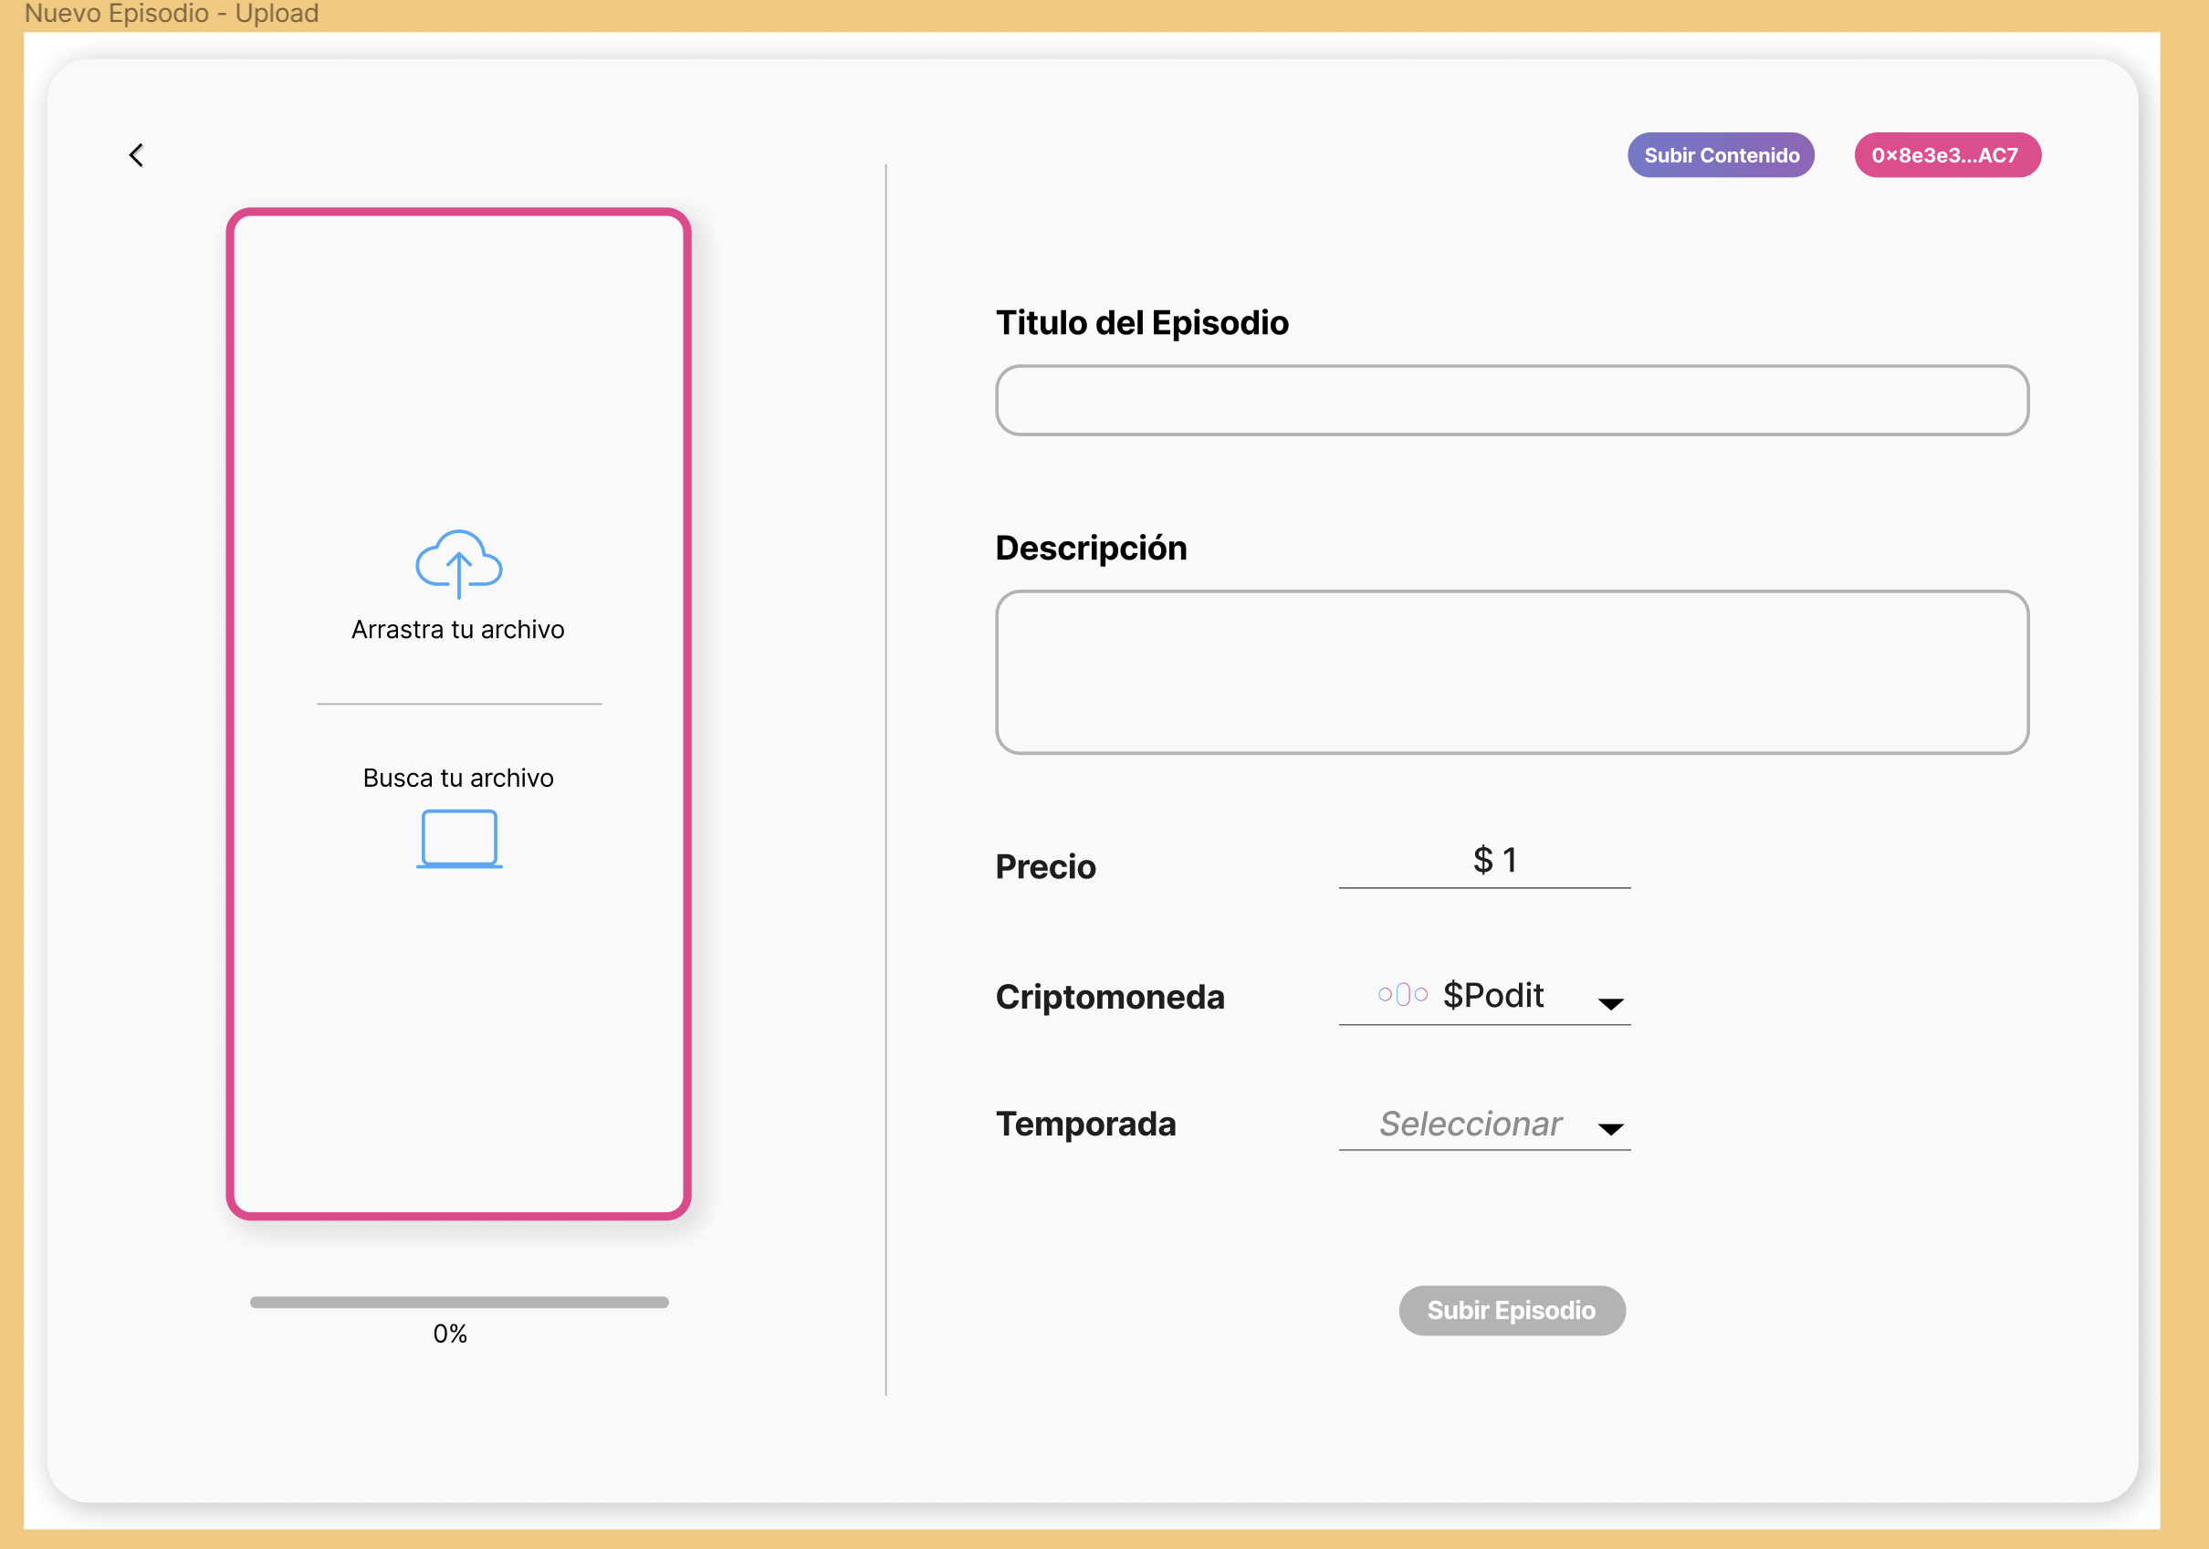

Solution
Present a tool that allows them to obtain income in a faster way and with a new business model based on the sale of income property.
In this way they can carry out the sale of a part of the entry rights, from the moment the digital file is available.

Slide 4

Present a tool that allows them to obtain income in a faster way and with a new business model based on the sale of income property.
Workflow
The creator and buyer have the posibility to send their tokens to anoter without to use exchanges or unsecured platforms
1
2
3
4
The creator upload their archieve to a descentralized storage.
And recieve digital elements to validate their content
The creator create a token that represents a rewards Token Property and put it on a market place.
Once by year the number of views there are stored on the main SC and the rewards recieveds there are splitted beetween the creator and the buyer
The buyer make aan offrer to buy this token that will enable to recieve a porcentaje of the rewards generated by the content views.
or
The buyer have the possibility to sell his Property Token.
It means more incomes to him and to the creator.
Acceso a productos financieros con ventajas heredadas
Banco País Origen
Banco País Destino
Score crediticio - Origen
Score crediticio - Destino

Slide 5
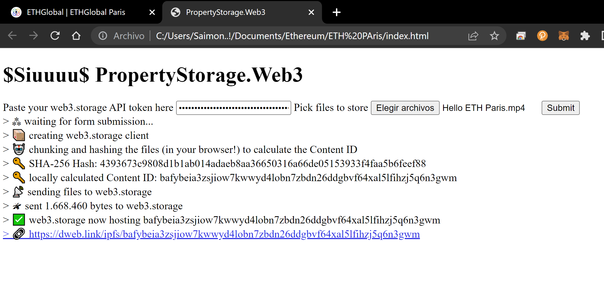
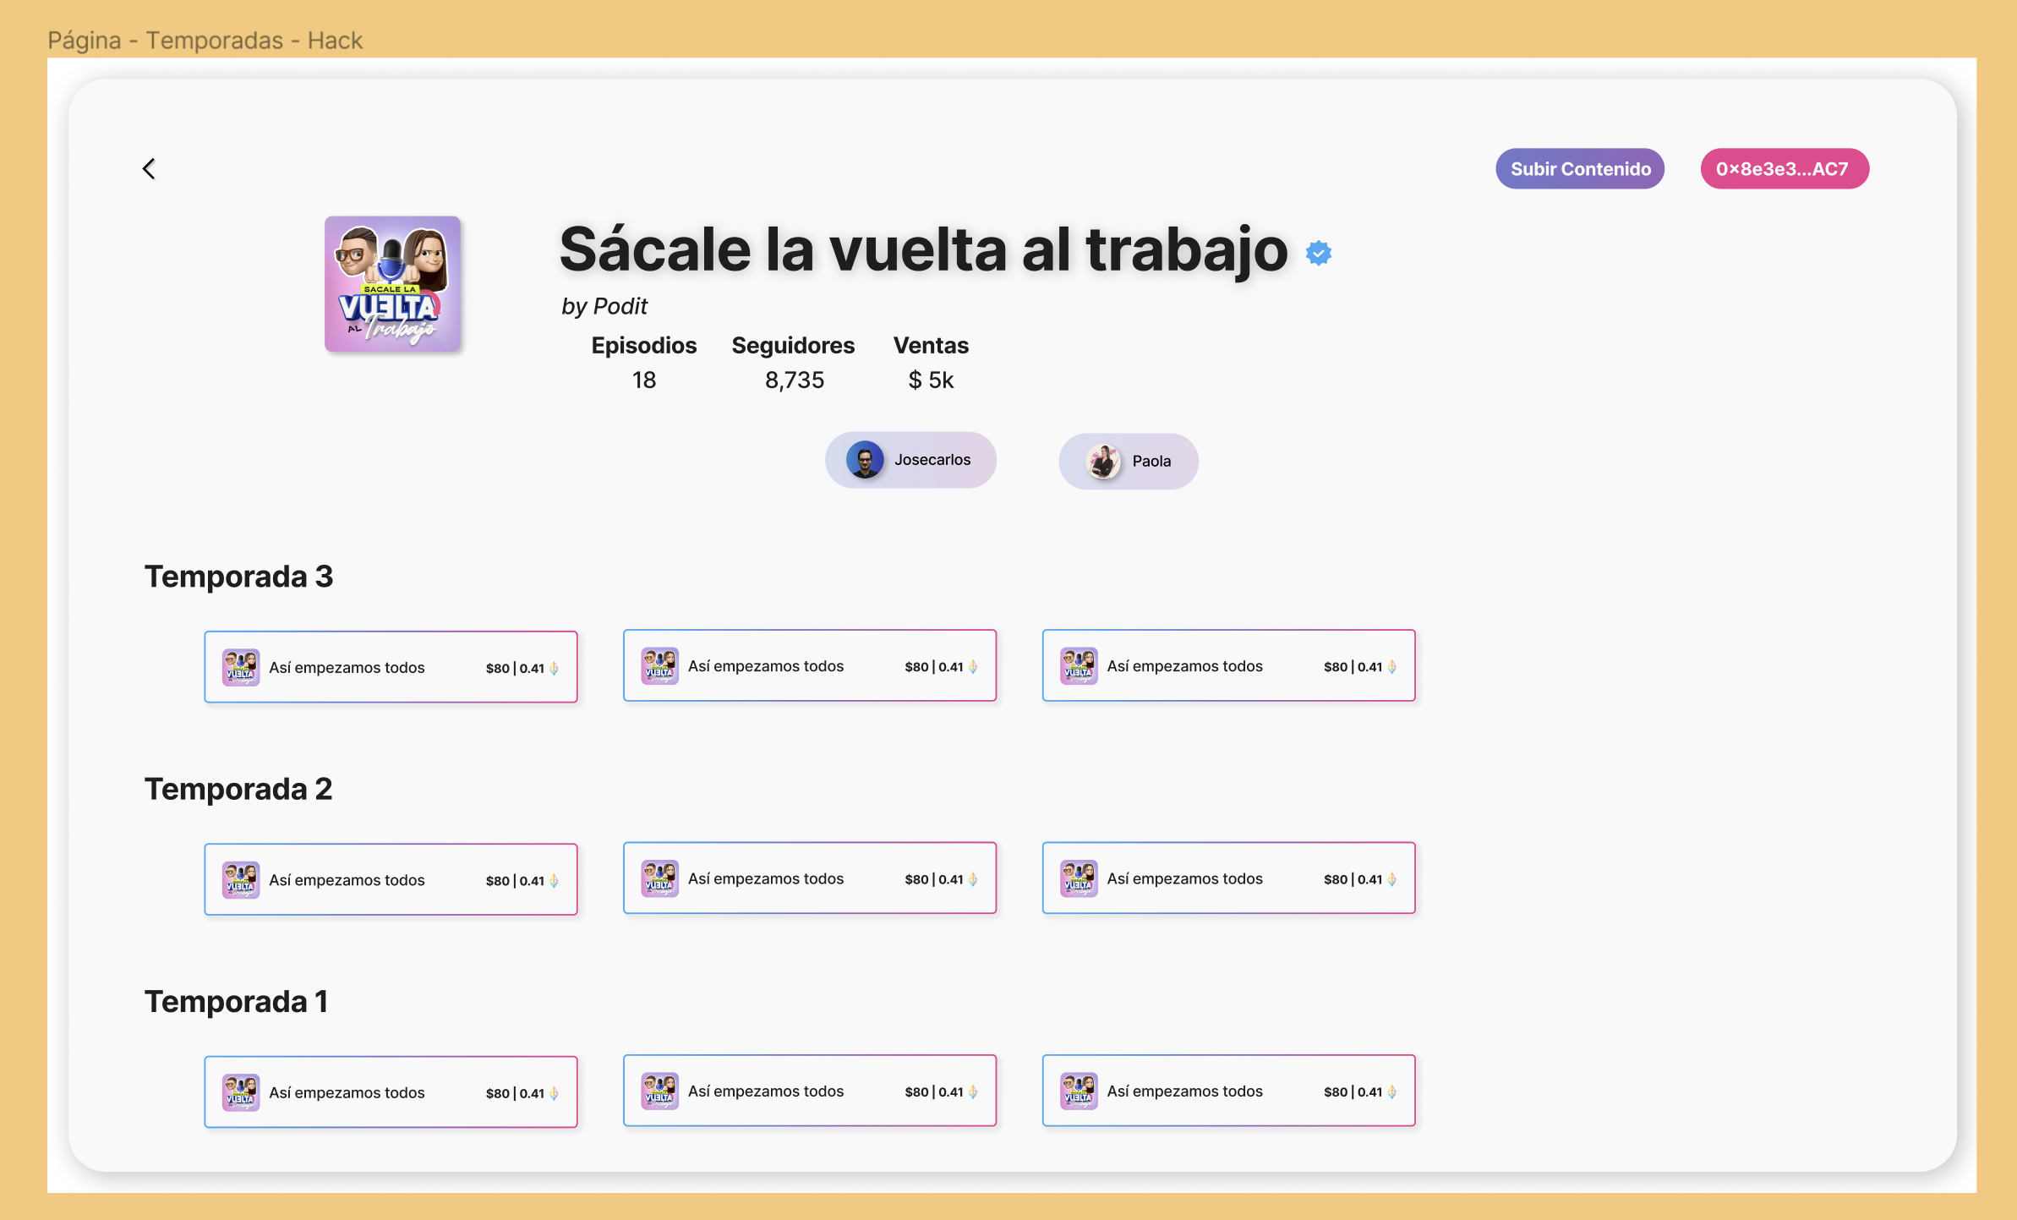
User experience (draw)
Upload content
Sell your property
Create your token property

Slide 6
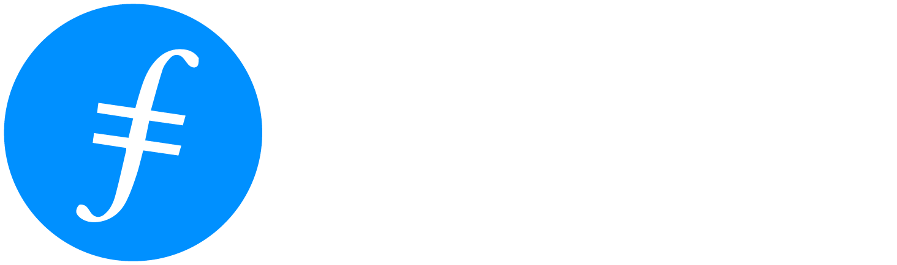



Present a tool that allows them to obtain income in a faster way and with a new business model based on the sale of income property.
Stack tech uses
The creator and buyer have the posibility to send their tokens to anoter without to use exchanges or unsecured platforms
1
2
3
4
The creator upload their archieve to a descentralized storage.
And recieve digital elements to validate their content
The creator create a token that represents a rewards Token Property and put it on a market place.
Once by year the number of views there are stored on the main SC and the rewards recieveds there are splitted beetween the creator and the buyer
The buyer make aan offrer to buy this token that will enable to recieve a porcentaje of the rewards generated by the content views.
or
The buyer have the possibility to sell his Property Token.
It means more incomes to him and to the creator.
Acceso a productos financieros con ventajas heredadas
Banco País Origen
Banco País Destino
Score crediticio - Origen
Score crediticio - Destino

Slide 7
Architecture solution
Remix API Chainlink SC to track the views that recieve the content
Open sea to créate the proterty token
Remix SC manage the token distribution for creator and buyer
Web3.storage to upload and the content and genetare the hash of the content
Chainlink automation service to upload the views value on SC
Remix CCPI Chainlink SC to send tokens to another Blockchain

Slide 8
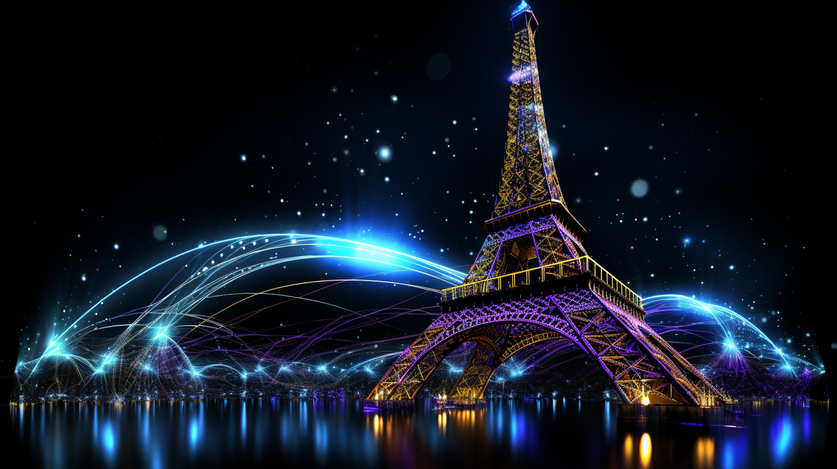

Merci
Thank you
Muchas gracias
DigiMedia
Github Repo: https://github.com/Themvp07/DigiContent-ETHGlobalParis
@simonxpe

